Slide 1
Milestone 1
13.05.2026
Team 2 (Zhenbo Gao, Baran Kiliç, Ben Garbe)

Slide 2
Overview
Tasks | Status | Notes
Explore hardware modules | Done
3D print sensor mounts | In progress | Camera mount printed Lidar mount designed
Robot movement | Done in simulation | Robot can move from one point to another with Nav2
Setup ROS2/ ROS2 Gazebo | Done | Integrated a simulated lidar to map the area
SLAM-algorithm simulation/real world | Done (real world) | slam_toolbox mapping Map saved (pgm/yaml + posegraph/data) Localization mode /robot_pose topic

Slide 3
Tasks & Responsibilities
Zhenbo Gao
  SLAM & Localization: Real-time mapping with slam_toolbox; publishes /map, /robot_pose
  Perception & Object Detection: Color recognition (HSV) + 3D block pose via RealSense depth camera
Baran Kiliç
  Ros2 / Gazebo Simulation
Ben Garbe
  Hardware
  Robot Arm Control

Slide 4
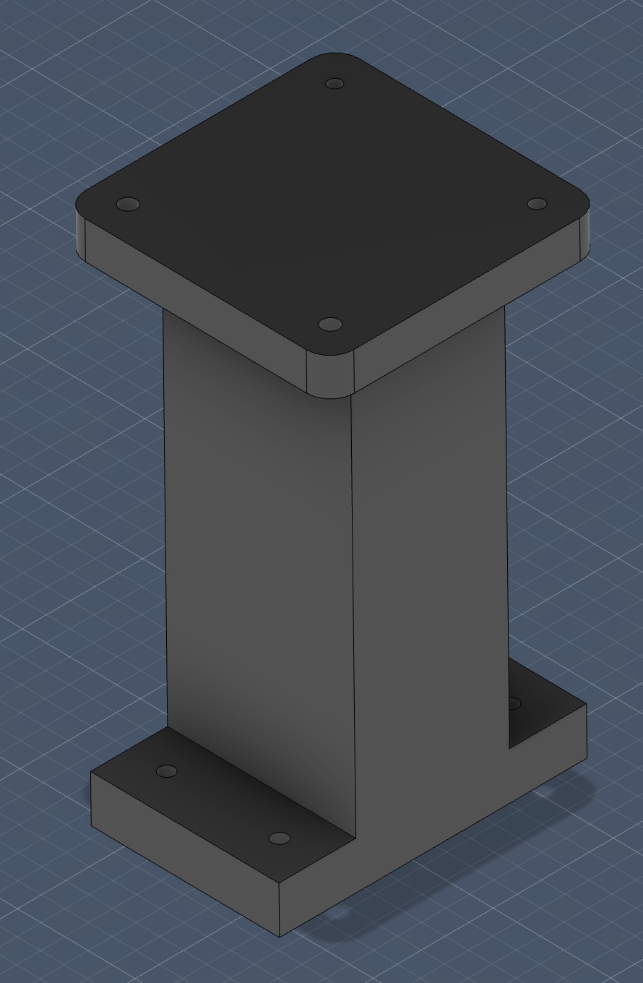
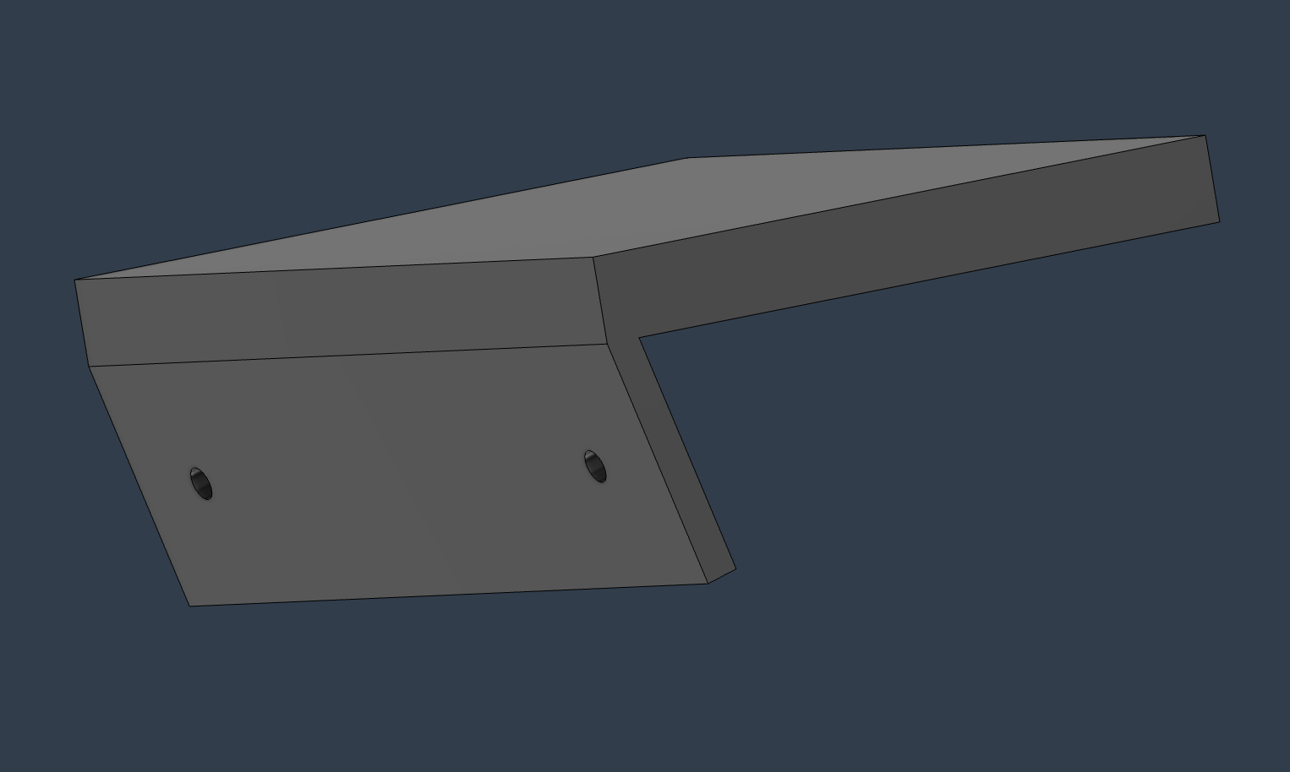
Hardware Tasks
Sensor Mounts
First Version of Kamera mount designed and printed
Lidar tower mount designed

Slide 5
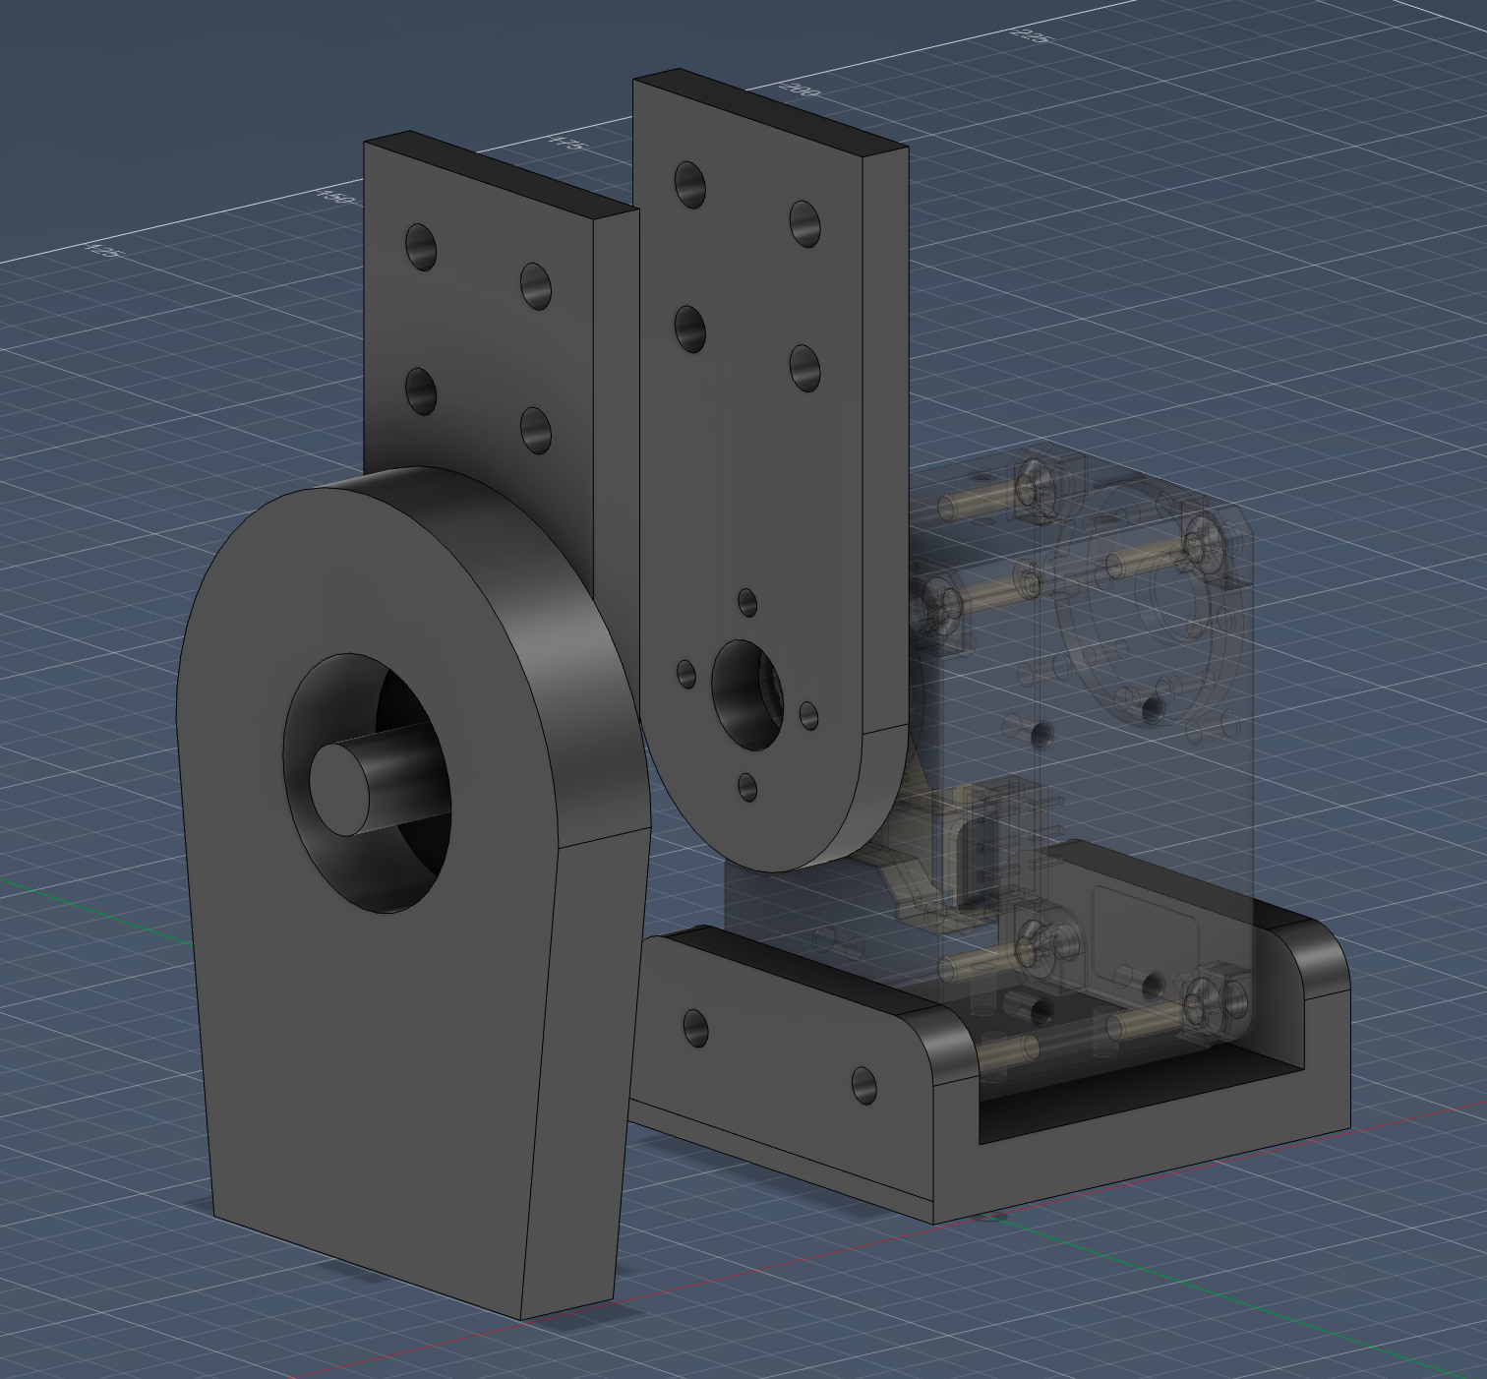
Hardware Tasks
Robot Arm
Started with design for 2 DoF Robot Arm

Slide 6
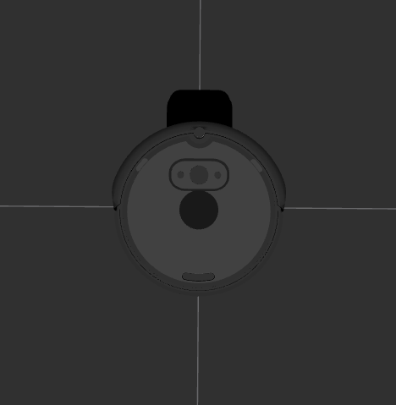
Ros2 and Gazebo Tasks
RVIZ and Gazebo
RVIZ with robot with a simulated lidar sensor

Slide 7
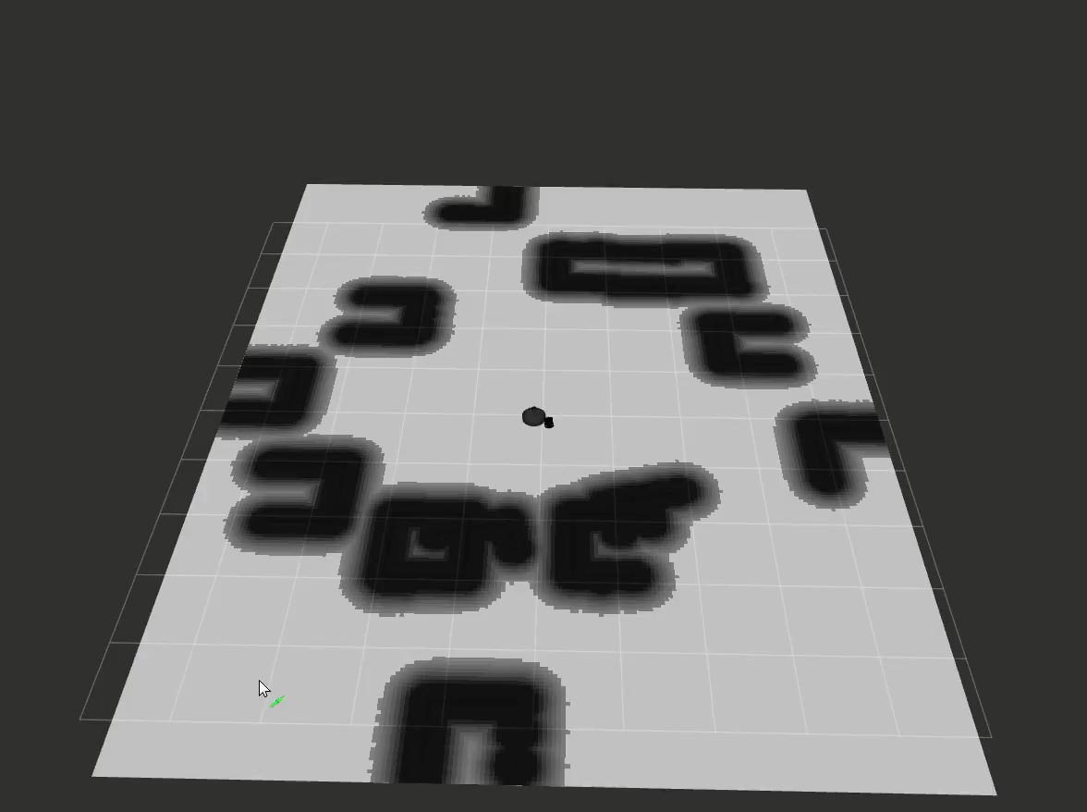
Ros2 and Gazebo Tasks
Nav2 navigation
Nav2 navigation showcase

Slide 8
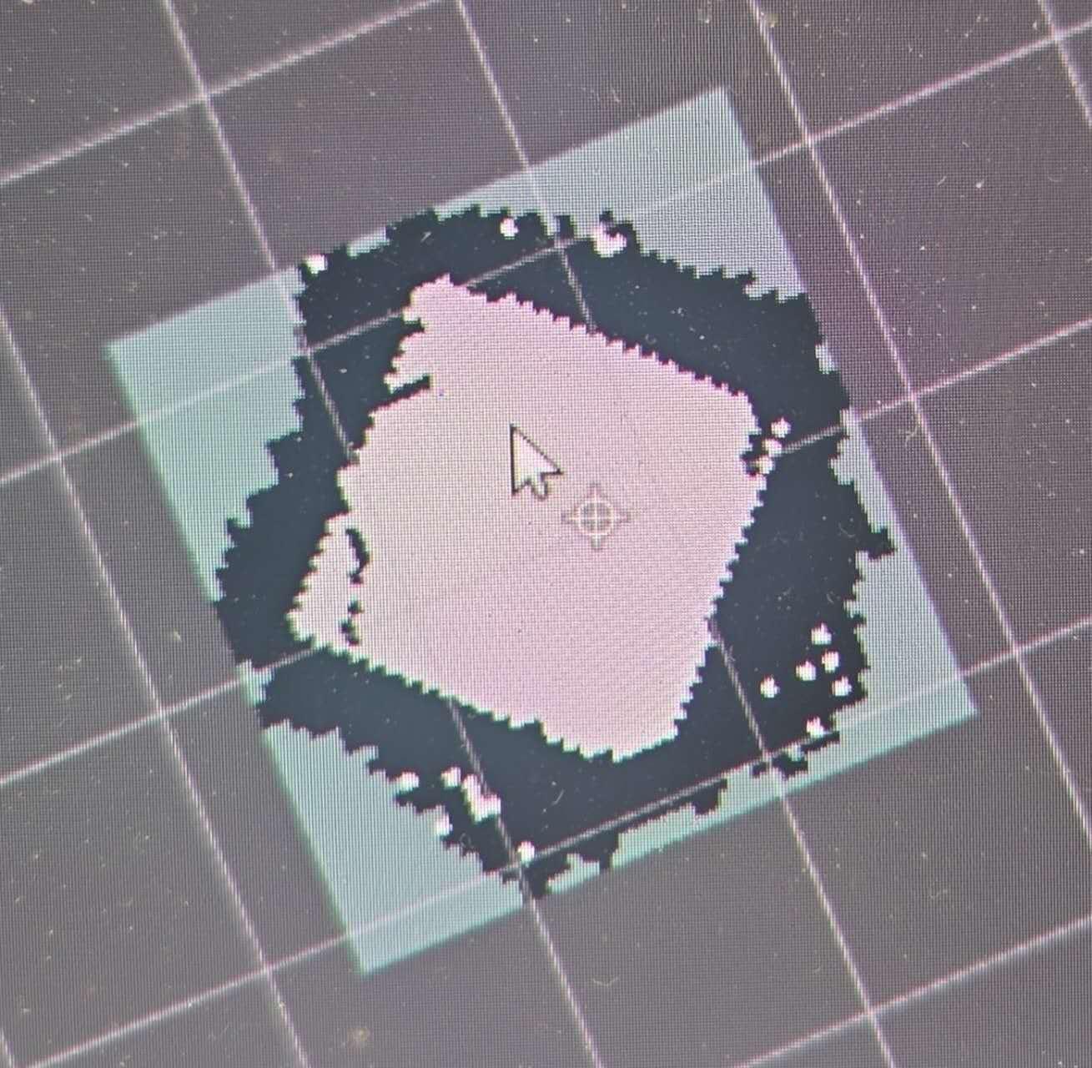
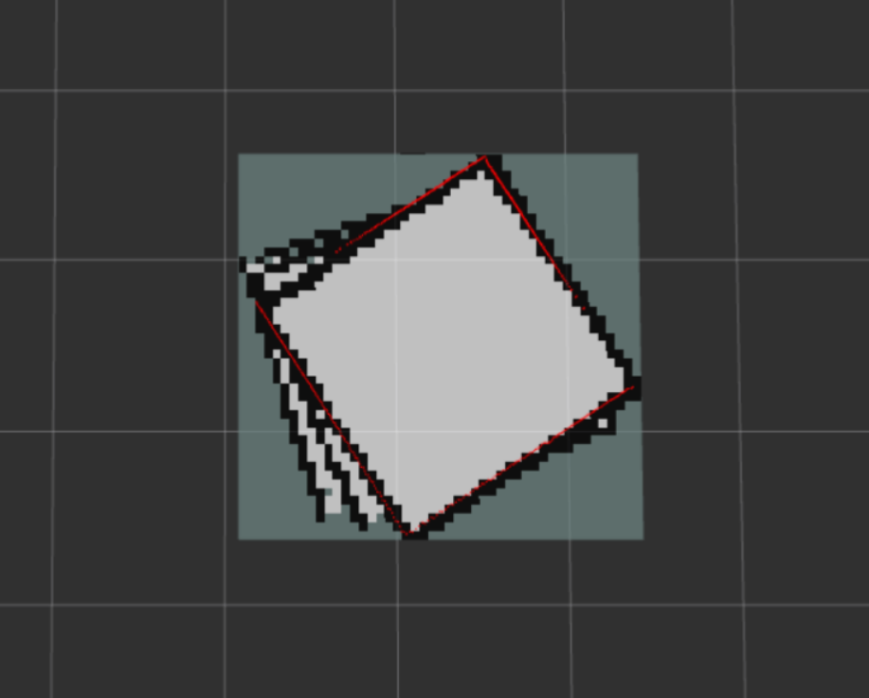
SLAM Tasks
SLAM: Mapping & Localization
Mapped the arena using slam_toolbox
LIDAR scan fused with wheel odometry
Map size: 2.25 m × 2.35 m, covering the 2 m × 2 m arena
Saved in pgm/yaml + posegraph/data format
Slow speed
Medium speed
Localization mode: robot loads pre-built map and estimates its position in real time using LIDAR
/robot_pose topic: outputs current position (x, y, heading) at 10 Hz → consumed by Nav2

